Slide 1
OLAP operations

Slide 2
Typical OLAP Operations
Roll up (drill-up): summarize data
  by climbing up hierarchy or by dimension reduction
Drill down (roll down): reverse of roll-up
  from higher level summary to lower level summary or detailed data, or introducing new dimensions
Slice and dice:
  project and select
Pivot (rotate):
  reorient the cube, visualization, 3D to series of 2D planes.
Other operations
  drill through: through the bottom level of the cube to its back-end relational tables (using SQL)

Slide 3
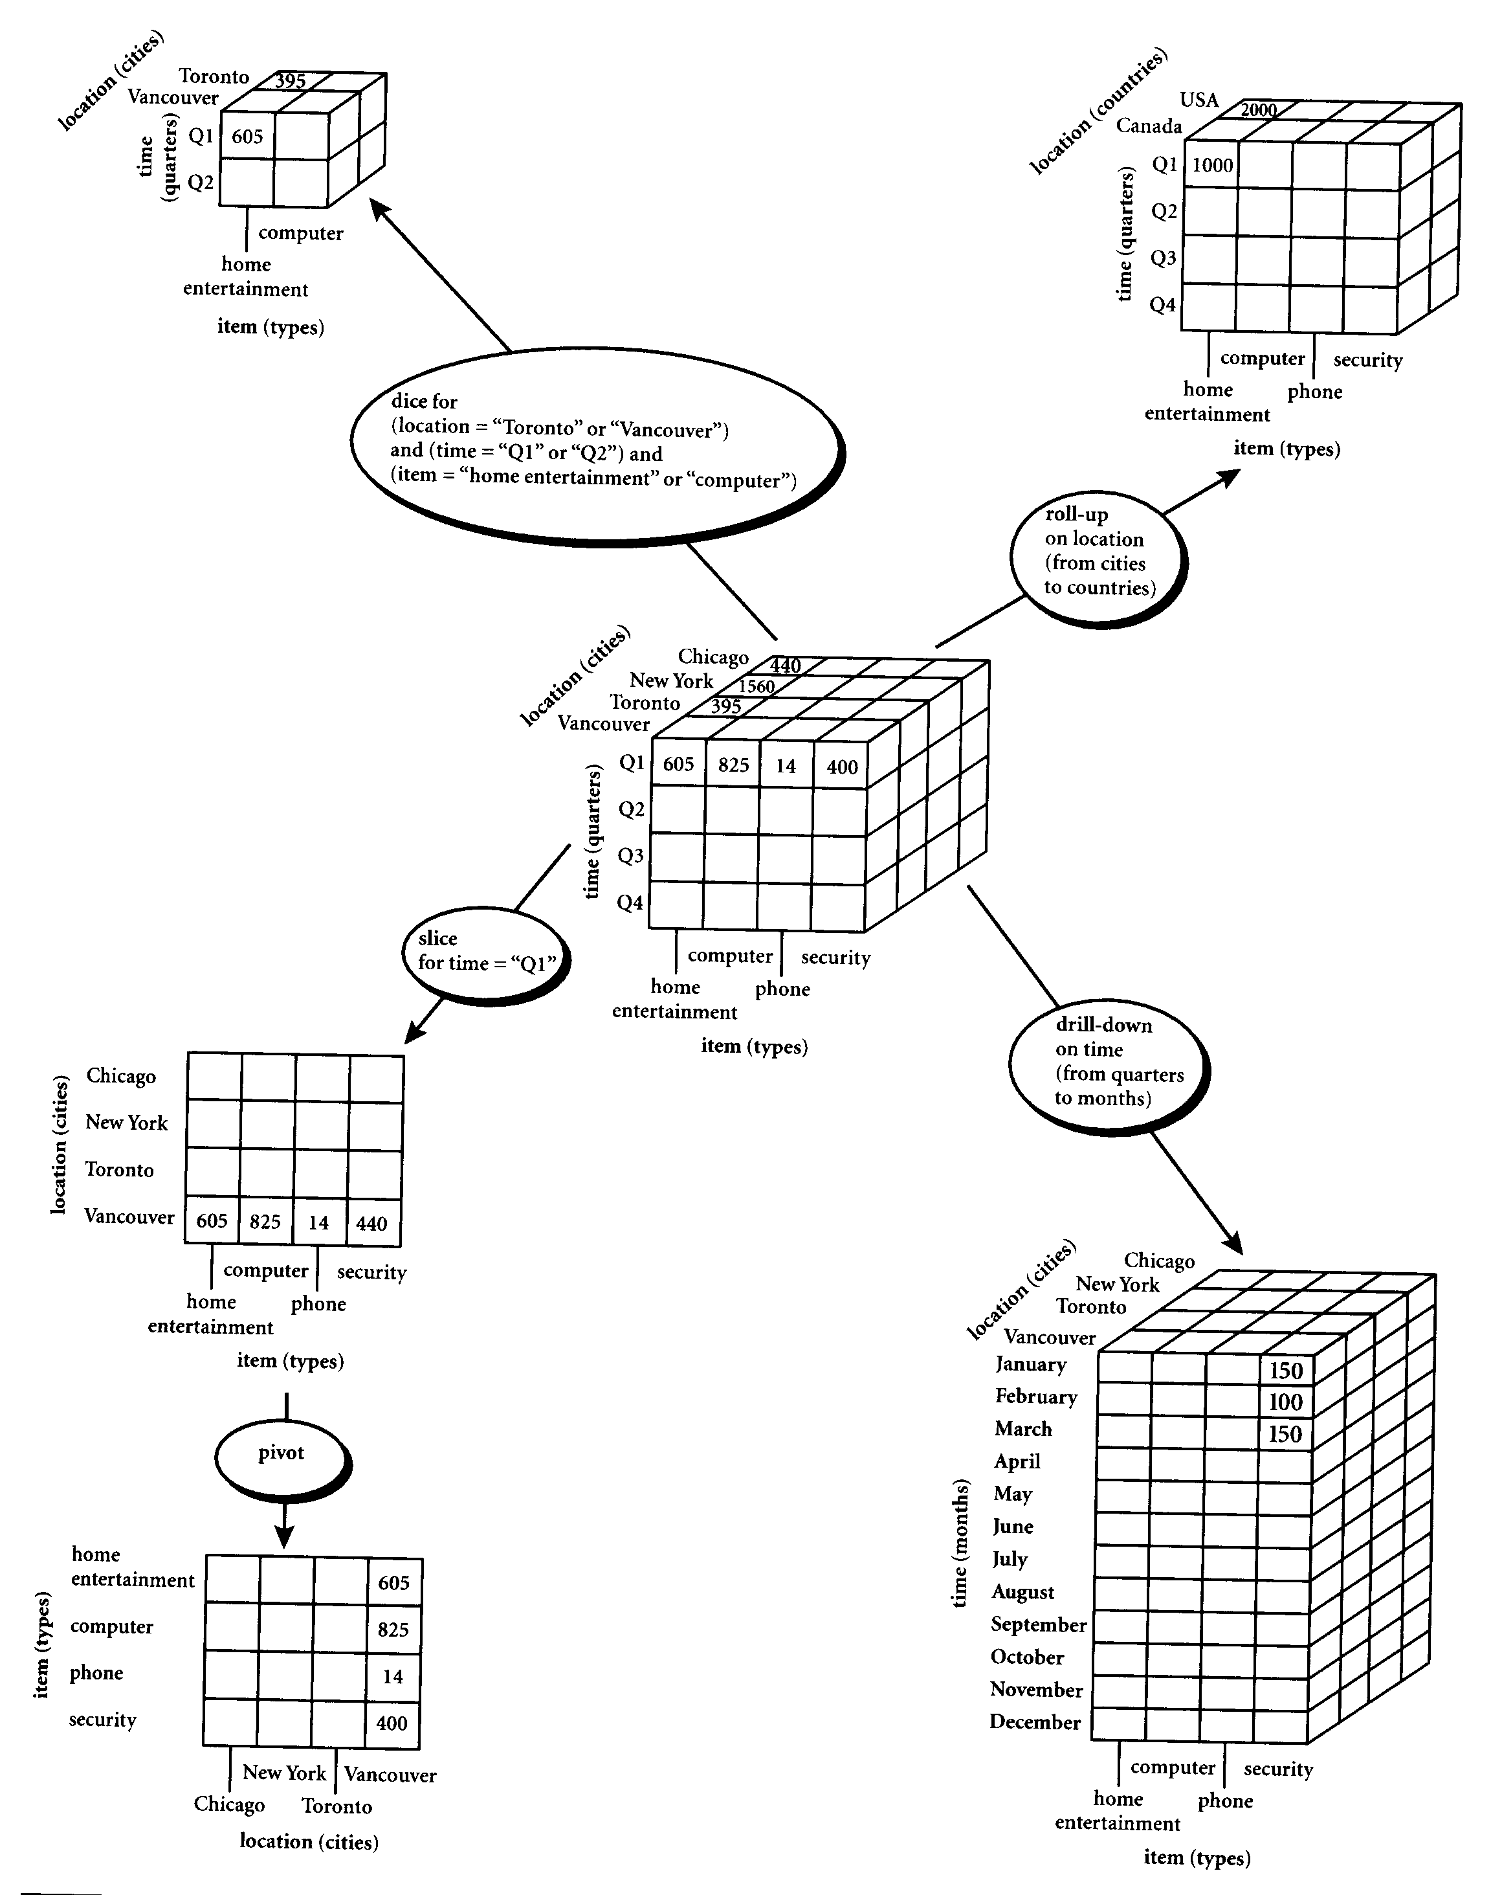

Slide 4
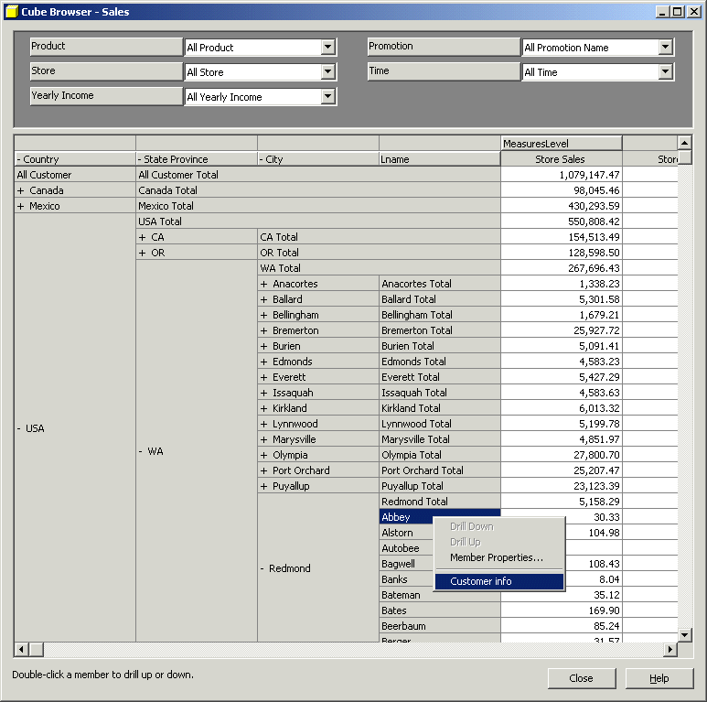

Slide 5
Cube Operation
Cube definition and computation in OLAP
    define cube sales[item, city, year]: sum(sales_in_dollars)
    compute cube sales
Transform it into a SQL-like language (with a new operator cube by)
    SELECT item, city, year, SUM (amount)
    FROM SALES
    CUBE BY item, city, year
Need compute the following Group-Bys
    (date, product, customer),
    (date,product),(date, customer), (product, customer),
    (date), (product), (customer)
    ()
()
(city)
(item)
(year)
(city, item)
(city, year)
(item, year)
(city, item, year)

Slide 6
Roll-up
Performs aggregation on a data cube
Either by climbing up a concept hierarchy for a dimension or by dimension reduction
One or more dimensions are removed from the given cube

Slide 7
Drill Down
Drill-down is the reverse of roll-up
It navigates from less detailed data to more detailed data
Drill-down can be realized by either stepping down a concept hierarchy for a dimension or introducing additional dimensions.

Slide 8
Slice and dice
The slice operation performs a selection on one dimension of the given cube, resulting in a sub_cube.
The dice operation defines a sub_cube by performing a selection on two or more dimensions.

Slide 9
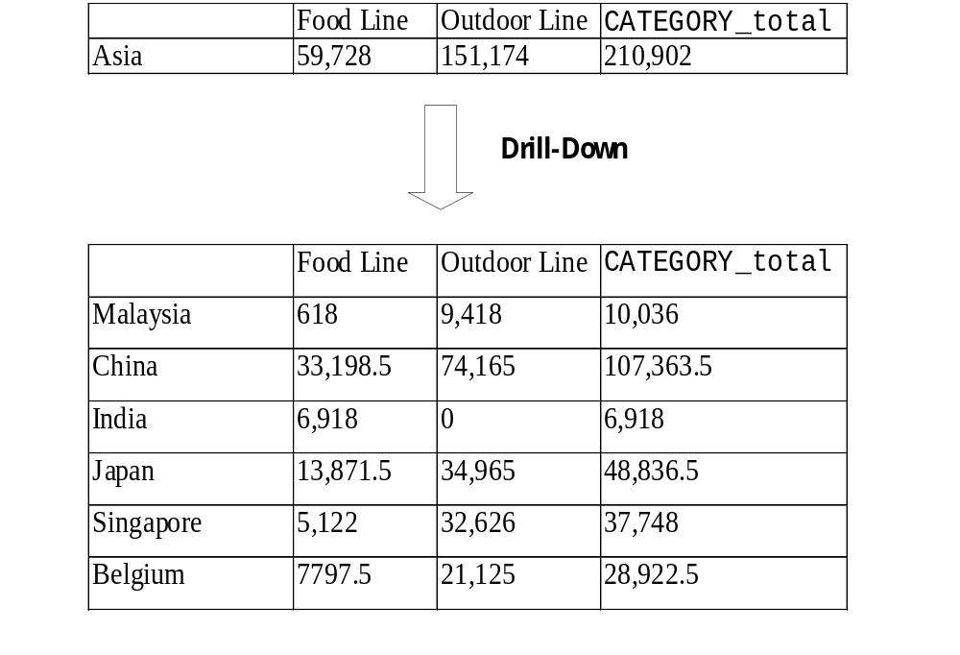

Slide 10
